Slide 1

Consumer Goods AD_HOC Analysis
PRESENTED BY:SUDHA MADHAVI

Slide 2
Objectives :-
1)AtliQ Hardware, a leading computer hardware company in India with a global
presence, recognizes the need for faster and better decision-making.
2)To improve this, the company is planning to strengthen its data analytics team by hiring junior data analysts.
3)They have identified 10 specific tasks for which they are looking for helpful insights.

Slide 3
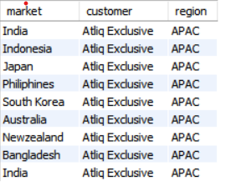
Query 1 . Provide the list of markets in which customer "Atliq Exclusive" operates its business in the APAC region.
Output
INSIGHTS : - AtliQ Exculsive operates its business in eight countries within the APAC region.

Slide 4

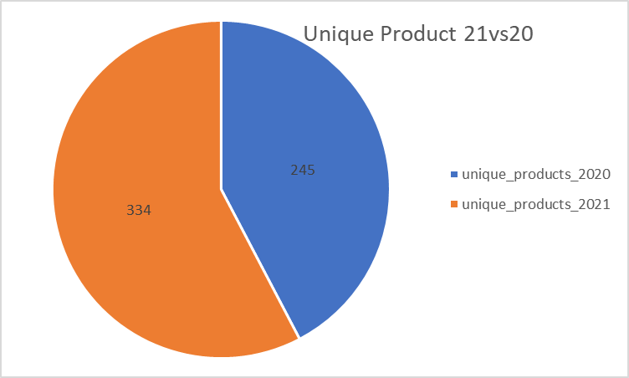
QUERY2. What is the percentage of unique product increase in 2021 vs 2020?
Output
Visual
INSIGHTS:-In 2020, we had 245 products, and in 2021, that number grew to 334, showing a 36% increase.

Slide 5
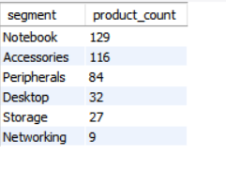
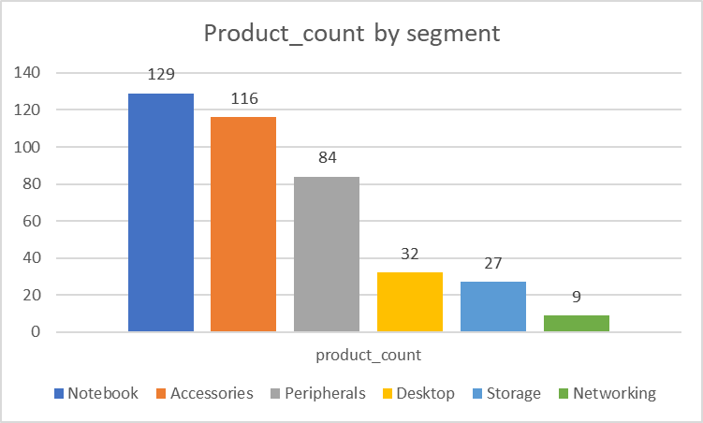
Query 3 . Provide a report with all the unique product counts for each segment and sort them in desecnding order of product counts .
Output
Visual
INSIGHTS:-The top three product categories are notebooks, accessories, and peripherals.

Slide 6
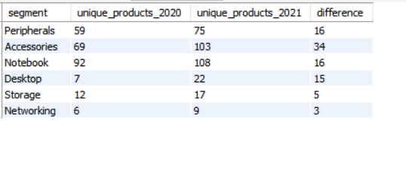
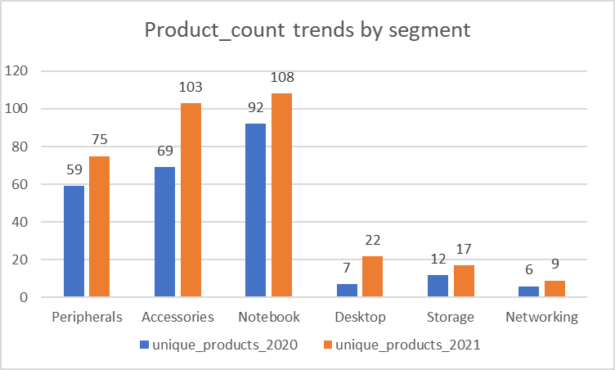
Query 4 . which segment had the most increase in unique products in 2021 vs 2020?
Output:
Visual:
INSIGHTS:-In 2021, the accessories segment had the highest number of unique products compared to 2020.

Slide 7
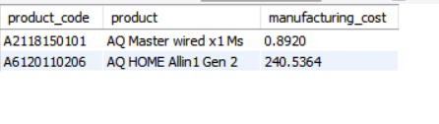
Query 5 . Get the products that have the highest and lowest manufacturing costs
Output:
INSIGHTS :- The AQ HOME Allin1 Gen 2 has the highest manufacturing cost, while the AQ Master Wired x1 MS has the lowest.

Slide 8
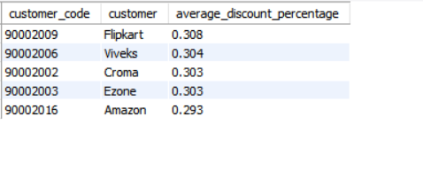
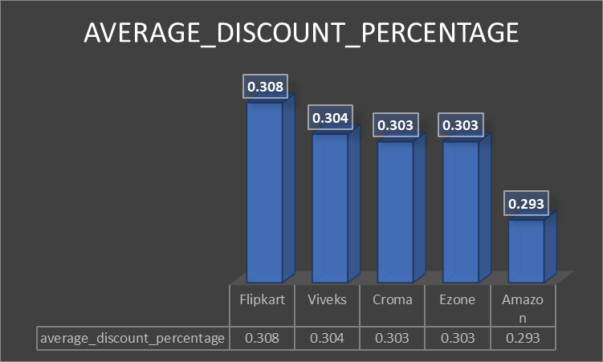
Query 6 . Generate a report which contains the top 5 customers who received an average high pre_invoice_discount_pct for the fiscal year 2021 and in the Indian market.
Output:
Visual:
INSIGHTS:-The top 5 retailers with the highest average discount percentages in the Indian market for 2021 are Flipkart, Viveks, Ezone, Croma, and Amazon.

Slide 9
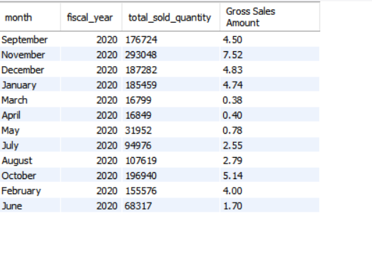
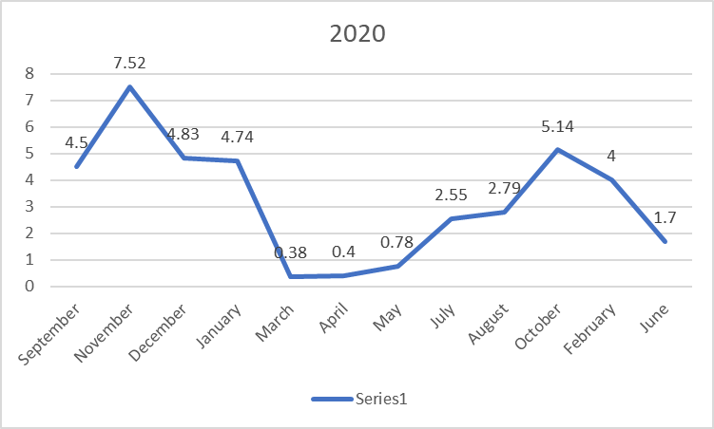
Query 7 . Get the complete report of the gross sales amount for the customer "AtliQ Exclusive" for each month. This analysis helps to get an idea of low and high performing months and take strategic decision.
Output:
Visual:

Slide 10
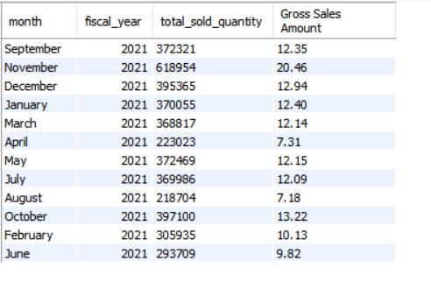
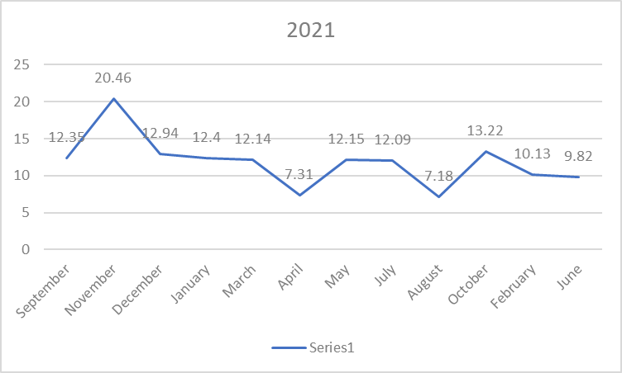
Query 7 . Get the complete report of the gross sales amount for the customer "AtliQ Exclusive" for each month. This analysis helps to get an idea of low and high performing months and take strategic decision.
Output:
Visual:

Slide 11
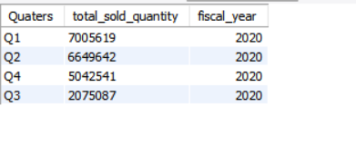
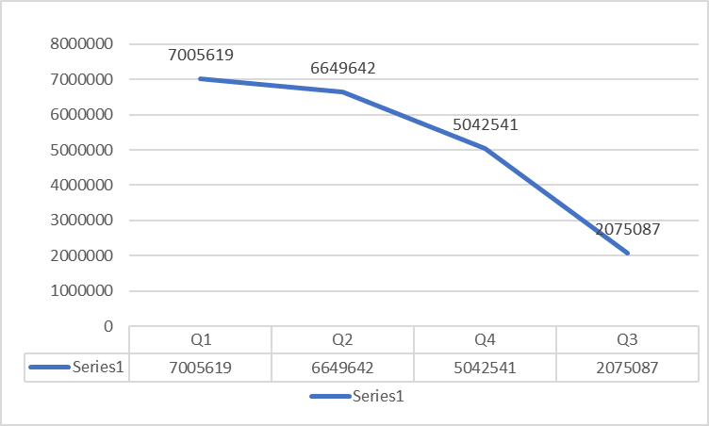
Query 8 . In which quarter of 2020, got the maximum total_sold_quantity?
Output:
Visual:
INSIGHTS :-The highest number of products was sold in the first quarter of 2020 (September, October, and November).

Slide 12
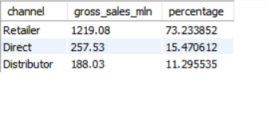
Query 9 . Which channel helped to bring more gross sales in the fiscal year 2021 and the percentage of contribution?
Output:
INSIGHTS :- The retailer channel significantly boosted gross sales in fiscal year 2021, contributing 73.23%.

Slide 13
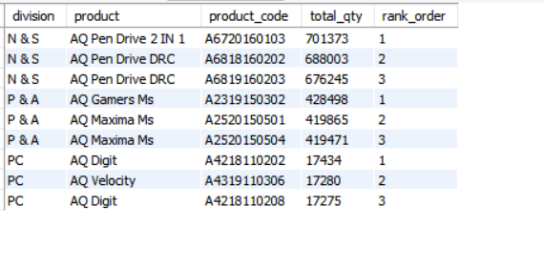
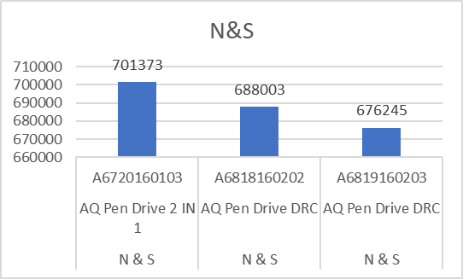
Query 10 . Get the Top 3 products in each division that have a high total_sold_quantity in the fiscal_year 2021?
Output:
Visual:

Slide 14
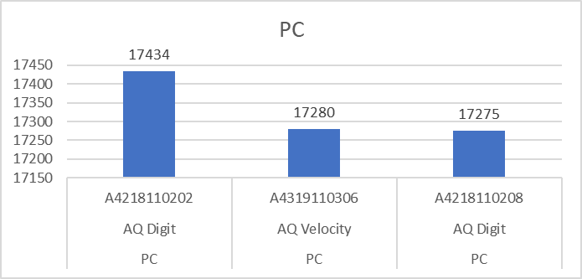
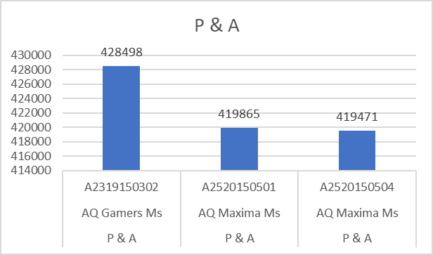
Query 10 . Get the Top 3 products in each division that have a high total_sold_quantity in the fiscal_year 2021?
Visuals:
The top-selling products in the fiscal year 2021 were:
N&S Division: AQ Pen Drive 2 in 1, AQ Pen Drive DRC
P&A Division: AQ Gamers MS, AQ Maxima MS
PC Division: AQ Digit, AQ Velocity

